Slide 1



Project Overview
KinaHub is a modern, local-first e-commerce and CRM platform designed to empower local sellers and neighborhoods in Nepal. It bridges the gap between physical stores and the digital shopping space — featuring a dynamic storefront, multi-seller cart, and an AI shopping assistant called Kina AI.
Dynamic Storefront
Multi-Seller Cart
Responsive React + Tailwind CSS UI
Optimized for local delivery fees
Kina AI
Real-time localized shopping advice
Demo: Kinahub.vercel.app

Slide 2
Problem Statement
The local retail market in Nepal faces critical digital barriers that KinaHub is designed to solve.
🏪 Visibility Gap
📦 Logistical Complexity
🤖 Lack of Personalized Guidance
Small local stores lack technical resources to build online storefronts, making them invisible to digital-first customers.
Customers ordering from multiple nearby stores face high, disjointed delivery fees — platforms don't optimize for local seller proximity.
Traditional e-commerce offers generic recommendations. Local shoppers need specific advice on value and localized convenience.

Slide 3

Project Objectives & Scope
Objectives
Scope
    Build a responsive frontend with React + Tailwind CSS
    Implement a secure backend via Django REST Framework
    Integrate OpenRouter API for AI-powered shopping advice
    Simplify business management for local sellers via a CRM dashboard
End-to-end e-commerce development including:
    JWT user authentication
    Product listing & categorization
    Brand management
    Multi-seller cart optimization
    Comprehensive seller dashboard
Scope limited to a functional prototype for local testing and school demonstrations.

Slide 4

OJT Workplace & Context
The OJT was conducted at the Computer Engineering Department, Shivapuri Secondary School, in a professional development studio environment.
Design-First Workflow
Wireframing in Figma before coding to ensure systematic software design.
Agile Methodology
Project broken into sprints: Cart Implementation, API Endpoints, AI Integration.
Infrastructure
School-provided workstations and internet access for real-time API testing.

Slide 5




Technology Stack
KinaHub uses a decoupled architecture — frontend and backend evolve independently.
Frontend
Backend
React.js + TypeScript · Vite build tool · Tailwind CSS · Framer Motion
Django · Django REST Framework (DRF) · ORM for database management
AI Layer
Security
OpenRouter API · Gemma & Nemotron LLMs · Client-side streaming responses
JWT authentication · Slug-based routing · Verified purchase reviews

Slide 6
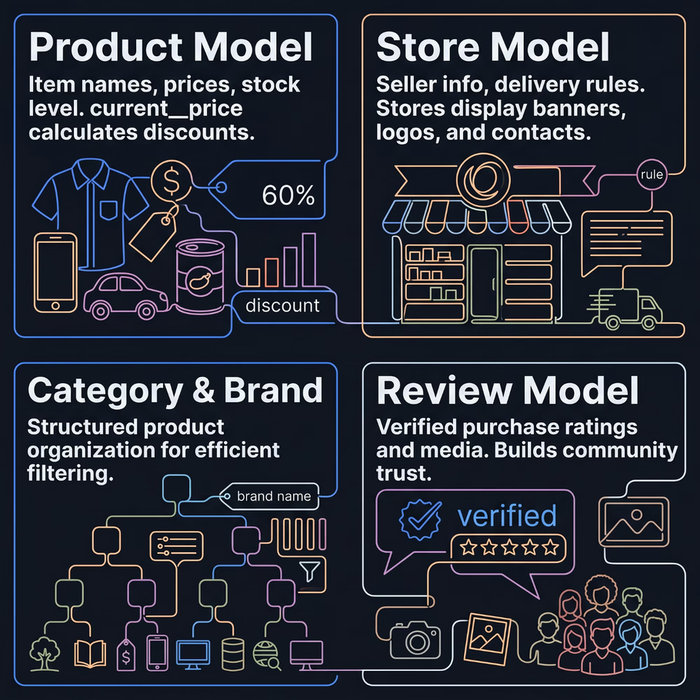
Backend Data Models
Core Architecture
The backend is built around four interconnected models that power every feature of the platform — from product discovery to seller management and community trust.
    Product: Handles dynamic pricing with current_price for discounts
    Store: Manages seller identity and delivery rules
    Category/Brand: Enables the advanced filtering system
    Review: Builds social proof via verified purchases

Slide 7


Slide 8
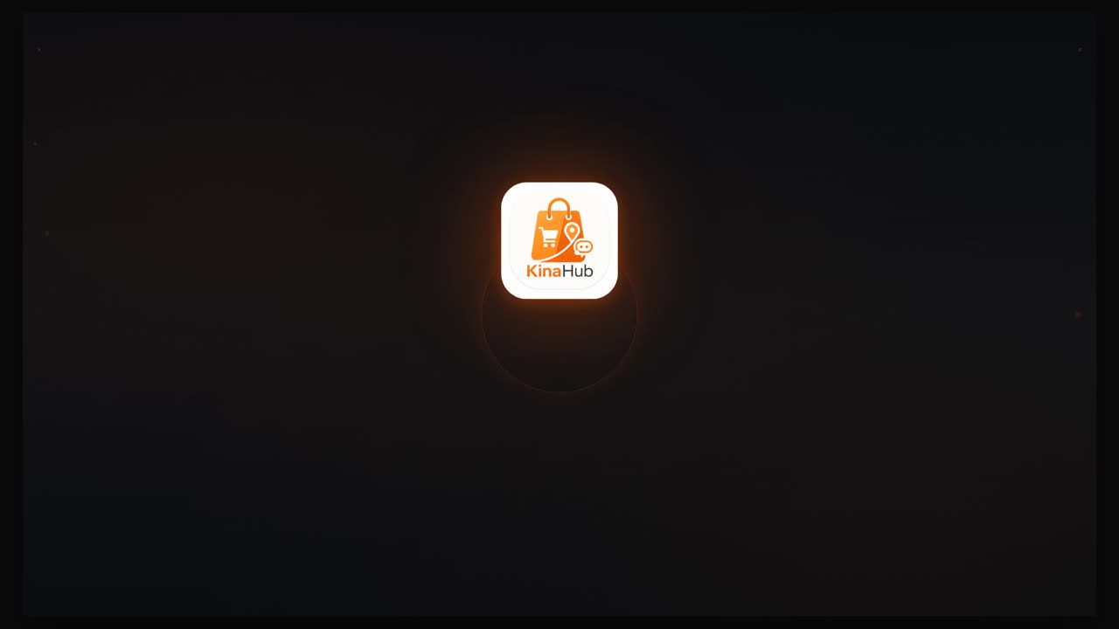

Slide 9
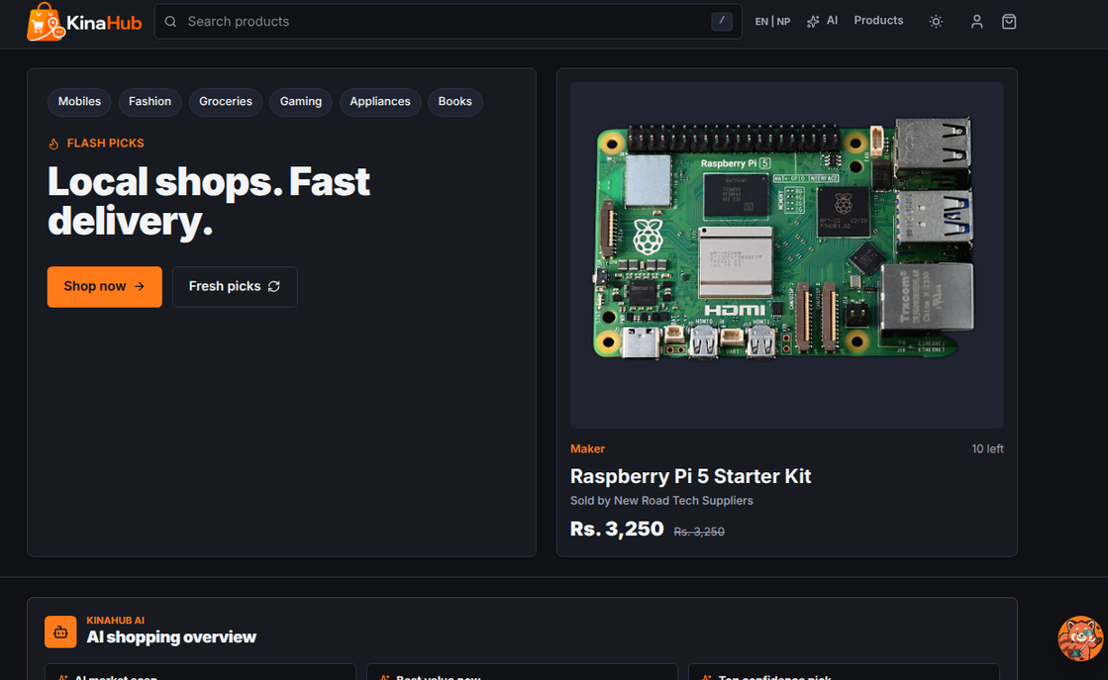
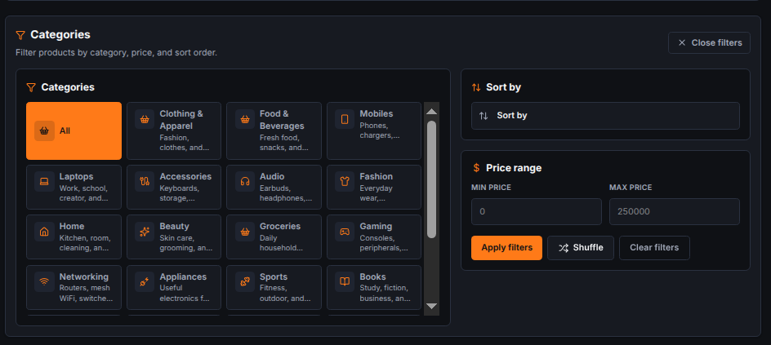
Platform Features Showcase
Each module was designed with user experience as the primary focus.
Landing Page
Filtering & Search
High-impact design with clear navigation
Price, brand, rating filters + instant full-text search

Slide 10
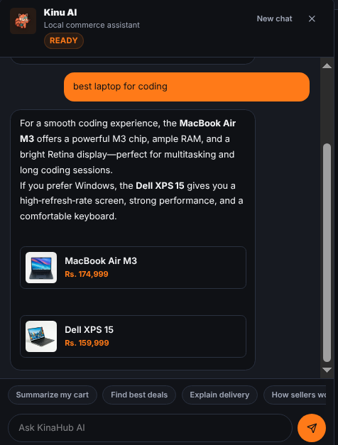
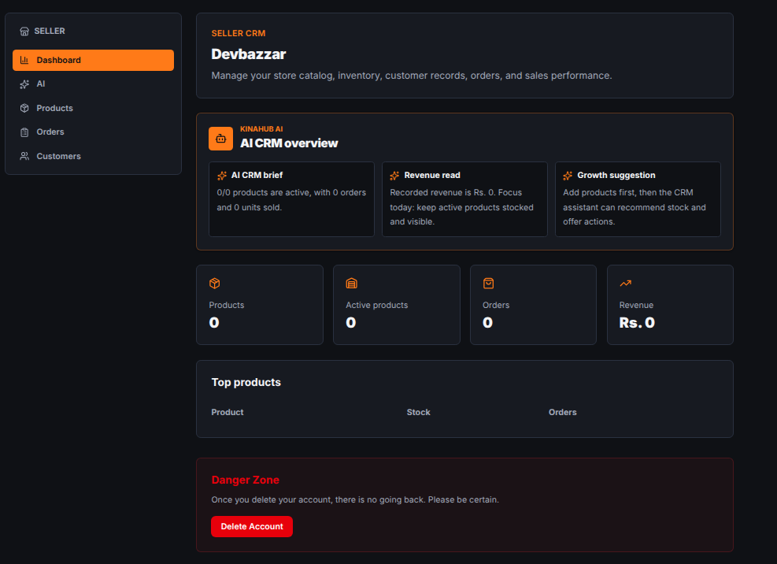
Kina AI
Seller CRM
LLM-powered shopping assistant with localized advice
Comprehensive dashboard for local sellers

Slide 11
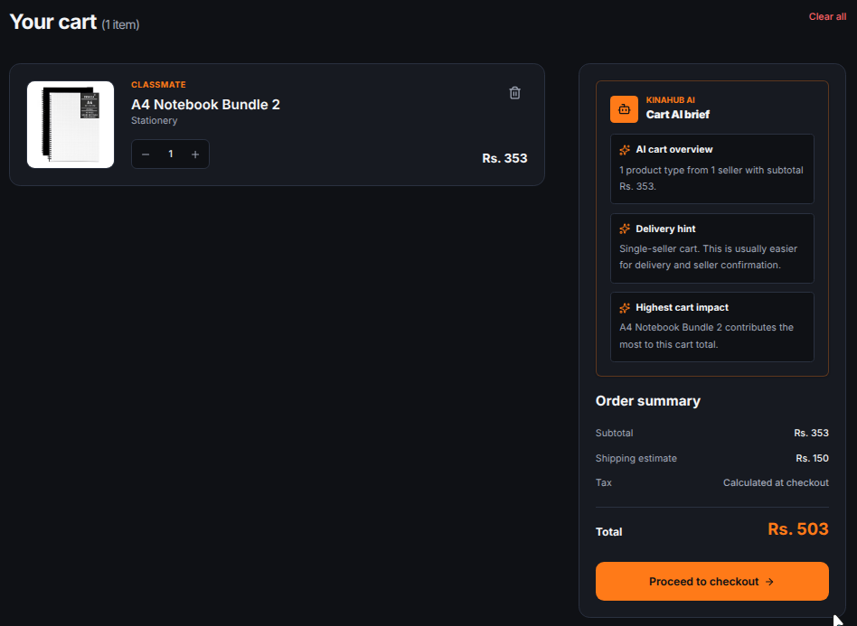
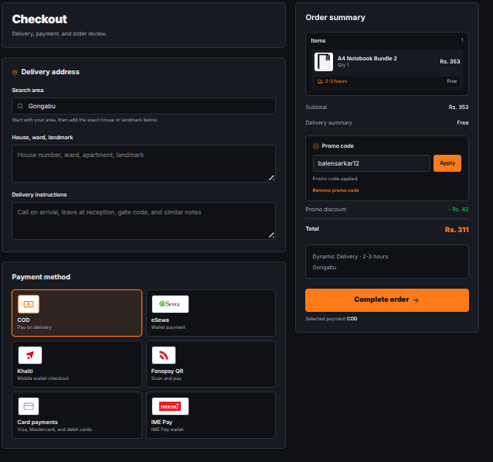
Multi-Store Cart
Secure Checkout
Logic-heavy cart optimized for multi-seller orders
Multi-step process for high security and low friction

Slide 12



OJT Learnings & Skills Acquired
1
Full-Stack Integration
Connecting Django REST backend with a Vite-powered React frontend using TypeScript for type safety.
2
Advanced CSS & UI/UX
Using Tailwind CSS for responsive, theme-aware interfaces with Framer Motion animations.
3
AI Orchestration
Designing prompts and handling streaming LLM responses from the OpenRouter API.
4
Version Control
Maintaining clean Git history and managing feature branches throughout development.

Slide 13

Conclusion & Future Roadmap
Conclusion
Future Recommendations
KinaHub successfully achieved its goals as a functional, local-first e-commerce platform. For a Grade 10 student, this OJT was a transformative experience — bridging school-level ICT and professional software engineering. It stands as proof that localized technology can empower communities.
    Real-time Notifications: WebSockets to alert sellers of new orders
    PWA Features: Offline shopping and push notifications
    Enhanced AI: Specialized model trained on local product data
This report is approved for partial fulfillment of Grade 10 Computer Engineering — Shivapuri Secondary School · Certified by Er. Sagun Babu Adhikari

